Slide 1
Satellite Data Project
Judith Kwassieu & Sergio Carrera

Slide 2
Why we changed Our project
Originally, we were doing the aircraft tracking project where we would go to a map and would be able to see the live locations of aircraft. We were able to get the graph running and the map running but no aircraft would show up for us. After testing and debugging with Sai, we discovered that data wasn’t being transmitted properly most likely because of network issues.

Slide 3
What our project does
This project receives data from NOAA satellites and records the data into wav files. We then use a program to view the image that the satellites transmitted at the time of recording which is saved in the wav files. The images should display satellite images of Earth.

Slide 4
What we’ve accomplished so far
We were able to get the graph running and were able to get wav file recordings. We were also able to view the images contained in the wav files using a program called WXtoImg. We were able to download and set up a program to allow us to view the live positions of the satellites we receive data from, the program is called Gpredict.

Slide 5
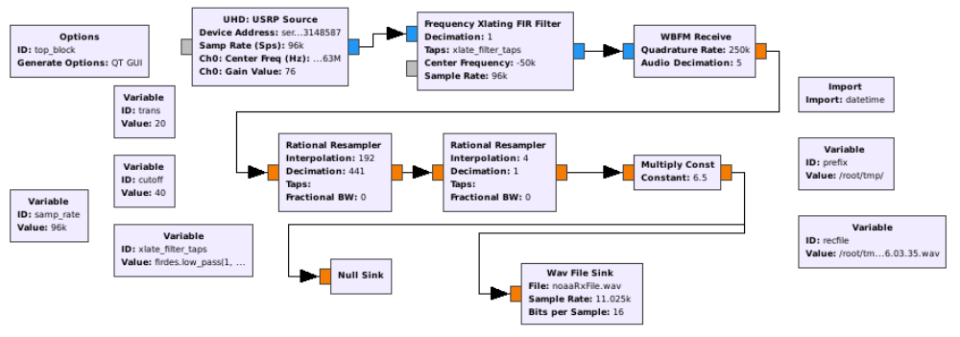

Slide 6
What we have left to do
As of right now, we believe our program is correctly recording data but when we view the images stored in the wav files, we see nothing that is recognizable. Even when the antennas were in range of receiving satellite data, we still didn’t get an actual map image. An issue is that we don’t have dish antennas which would receive data a lot better.

Slide 7
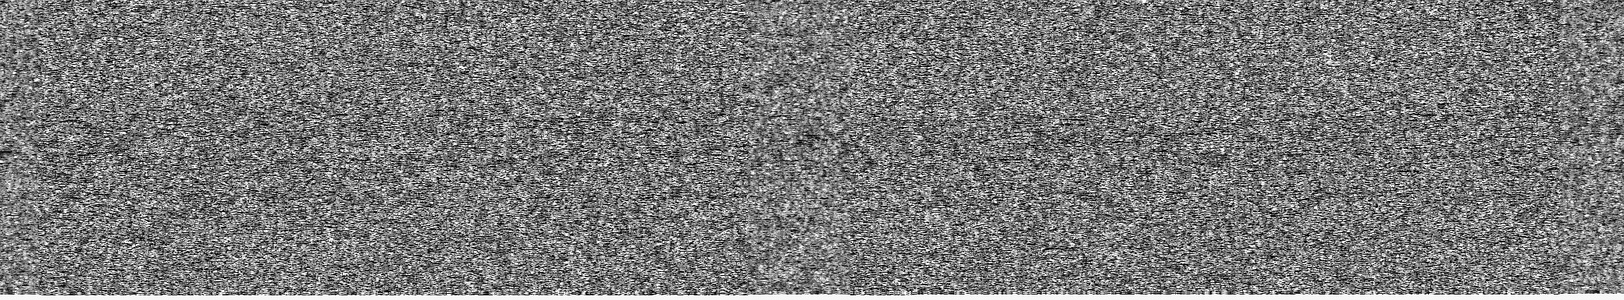
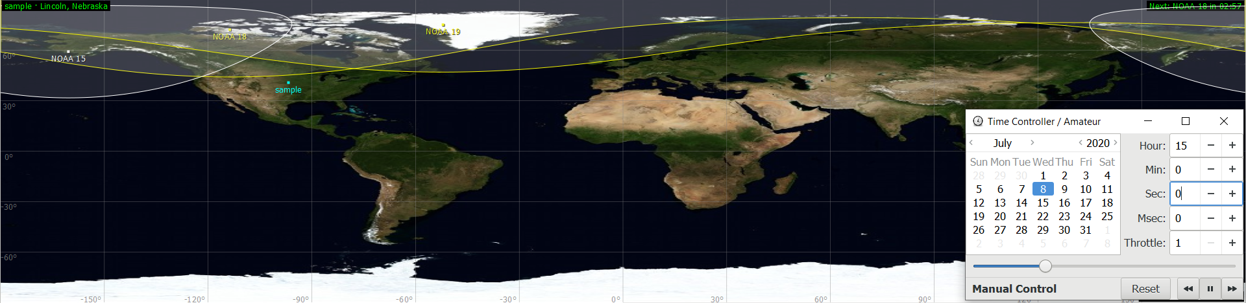
3:00 PM Recording

Slide 8

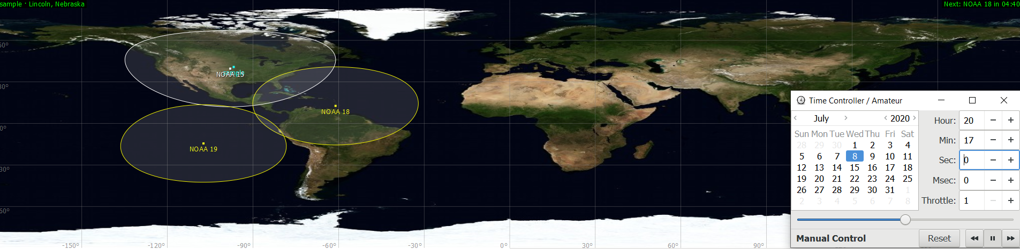
8:17 PM Recording

Slide 9
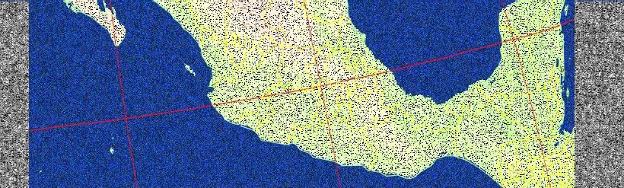

Slide 10
Struggles
Originally, we were thinking that we weren’t seeing map images simply because the satellites were out of range for the antennas to receive data from them, but even after doing a recording when the satellite was in range, we still didn’t get a map image like we expected to.

Slide 11

What each block does
UHD: USRP Source – acts as a receiver to collect data.
Frequency Xlating FIR Filter – performs frequency translation on signal and down samples the signal.
WBFM Receive – demodulates a signal, output is demodulated audio.
Rational Resampler – converts data to desired sample rate.
Multiply Const – multiplies input by a constant.
Wav File Sink – writes data to a file specified by the user.

Slide 12
Theoretical Analysis
We were thinking the satellite data could’ve been blocked at the time of data recording when the satellite was in range, but after researching, we now believe that wasn’t the case.

Slide 13
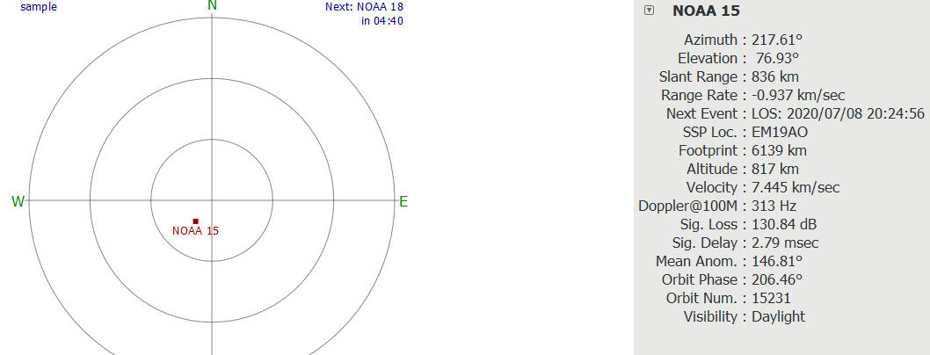
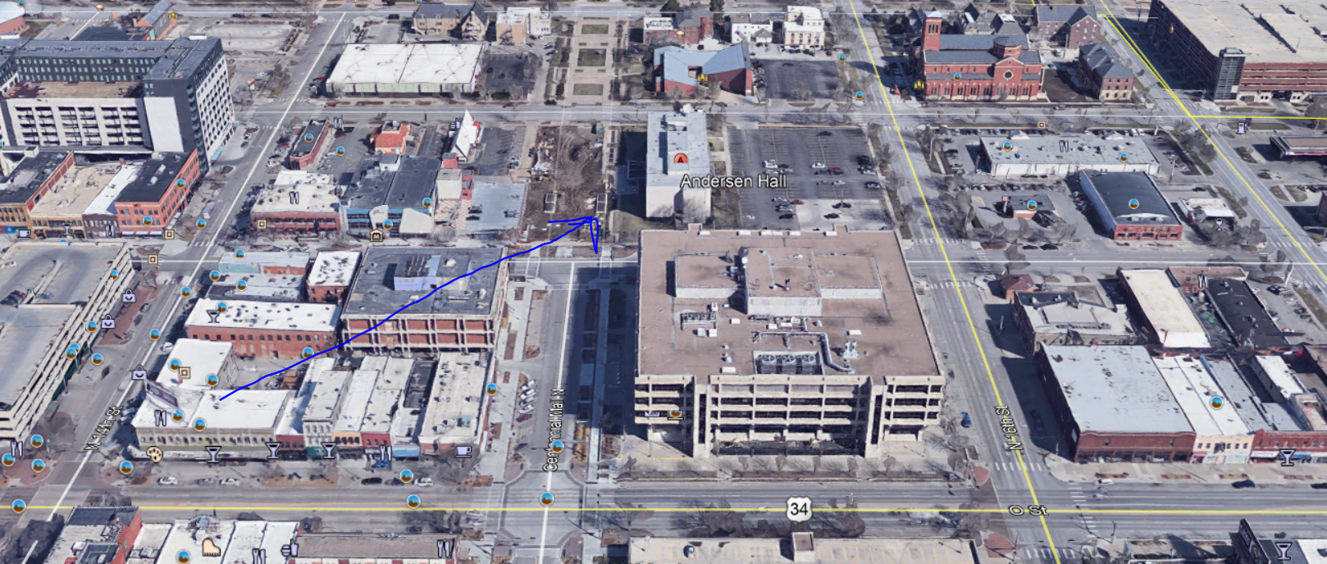

Slide 14
Questions?

Slide 15
References
M. Lunar, S. Suman, D. Rico, Leveraging iLNK Testbed to Acquire NOAA Satellite Weather Data for the State of Nebraska, CSCE 990 Final Project, 2020
https://wiki.gnuradio.org

